Slide 1
Map tag
The <map>….</map> tag is used to define a client-side image-map. An image-map is an image with clickable areas.
The <map>…. </map> tag contains a number of <area> tags, that defines the clickable areas in the image map.
<map name=“mapname” id=“mapname”>……… </map>

Slide 2
Area Tag
The <area> tag defines an area inside an image-map. An image-map is an image with clickable areas.
The <area> element is always nested inside a <map>….</map> tag.

Slide 3
Attribute | Value | Description
alt | text | Specifies an alternate text for the area. Required if the href attribute is present
coords | coordinates | Specifies the coordinates of the area
download | filename | Specifies that the target will be downloaded when a user clicks on the hyperlink
href | URL | Specifies the hyperlink target for the area
hreflang | language_code | Specifies the language of the target URL
media | media query | Specifies what media/device the target URL is optimized for
shape | default rect circle poly | Specifies the shape of the area

Slide 4
Attribute | Value | Description
target | _blank _parent _self _top framename | Specifies where to open the target URL
type | media_type | Specifies the media type of the target URL

Slide 5
Attribute | Value | Description
rel | alternate author bookmark help license next nofollow noreferrer prefetch prev search tag | Specifies the relationship between the current document and the target URL

Slide 6
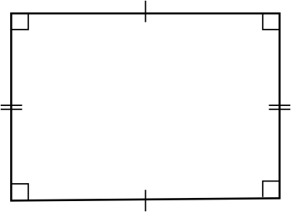
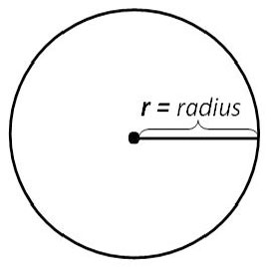
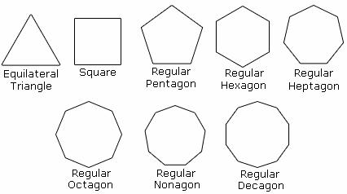
Coords attribute
Value | Description
x, y, x1, y1 | If rect, Specifies the coordinates of the left, top, right, bottom corner of the rectangle
x, y, radius | If Circle, Specifies the coordinates of the circle center and the radius
x, y, x1, y1 ,.., xn, yn | If poly, Specifies the coordinates of the edges of the polygon. If the first and last coordinate pairs are not the same, the browser will add the last coordinate pair to close the polygon

